Slide 1
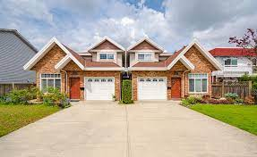
Online Home Searching
Anujit Deb
UG02-49-18-012

Slide 2

About The Website
This website is about searching many types of residence. The user can find any types of residence here according their need. Like,
House for rent.
House for buy and sell.
House for bachelors.
House for family.
Hotel booking system.
Resort booking system.
And so on…

Slide 3
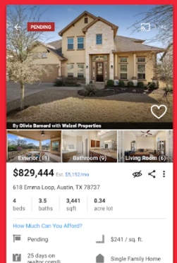
Other Facilities
In every category user can see the details about each type. Like,
User can see picture of the home/resort/hotel etc.
User can see the details about the home/resort/hotel etc.
User can contact with the management of home/resort/hotel etc.
User can book the home/resort/hotel etc.
User can rate and see the rating of the home/resort/hotel etc.
And so on…

Slide 4
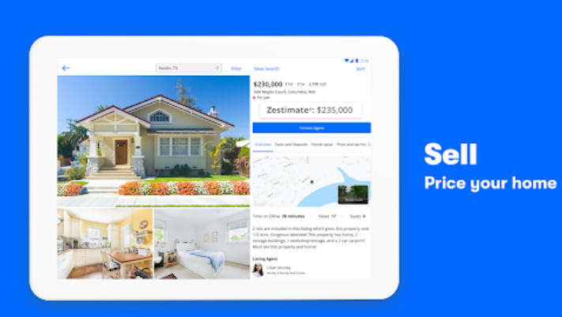
More Facilities
User can buy and sell residence or property here. User will pay my site for using some activities.
Few more option will be add during my development.

Slide 5


